Slide 1

Heart Disease Analysis and Predictions
Sandra botica
Ufuoma atakere

Slide 2

Overview
A breakdown of the dataset
Objectives
Visualizations and analysis
Model prediction
Machine learning

Slide 3
Get data
Read in csv
Clean and Prepare data
Remove all NaN
Train Model
Test Data
Optimize Data
Logistic
Notes:
Data was gotten from Kaggle

Slide 4
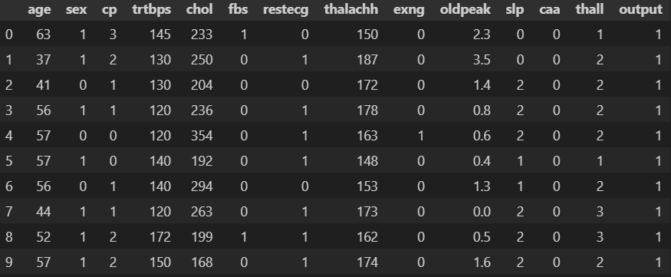
Dataset
Notes:
Cleaned and prepared removed all null values

Slide 5
About the DATASET
age : age of the Patient
sex: Sex of the Patient
ca: Number of Major Vessels (0-3)
cp: Chest Pain Type
1. typical angina
2. atypical angina
3. non-anginal pain
4. asymptomatic
trtbps: resting blood pressure(mmHg)
chol: cholesterol(mg/dl)
fbs: fasting blood sugar (>120mg/dl)(1=true,0=false)
restecg: resting electrocardiographic results:
0. normal
1. have abnormality
2.probable abnormality
thalach: maximum heart rate achieved
Output: Diagnosis
0-less chance of heart disease
1- more chance of heart disease
exng: exercise induced angina (1 = yes, 0 = no)
oldpeak: - old peak: ST depression induced by exercise relative to rest
slp: the slope of the peak exercise ST segment (0 = unsloping, 1 = flat, 2 = downsloping)

Slide 6







Data Exploration

Slide 7
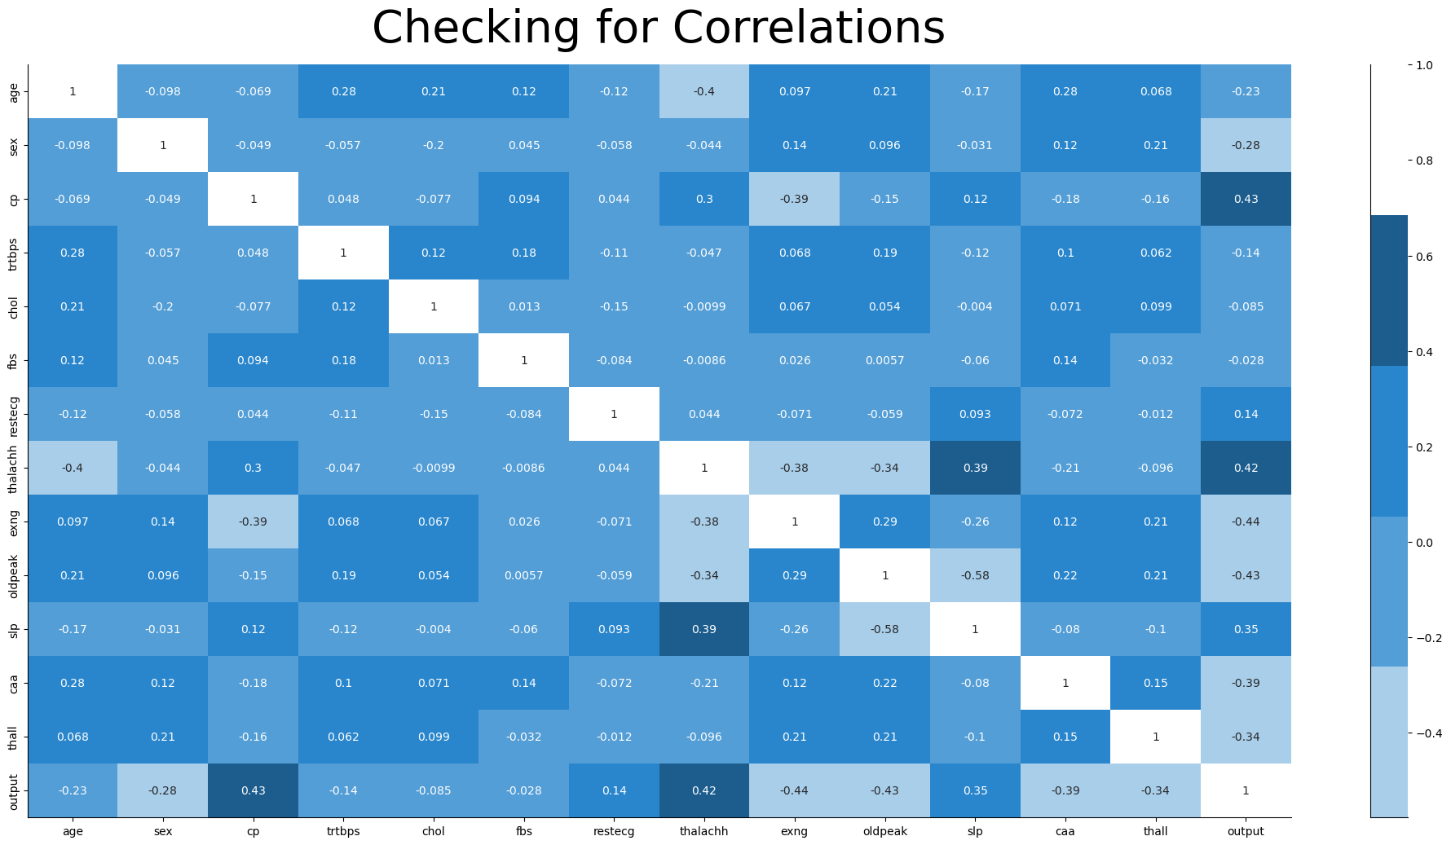
Notes:
Correlation was done to determine which features to drop for better accuracy

Slide 8
Logistic Regression

